Slide 1
Submission Guidelines
All,
A link will be shared via whatsapp and on the QR code sheet to all participants to submit links to your teams GitHub Repos and presentations. Please ensure the settings are public so there is no issues in viewing. Submissions are due at 9AM SHARP on 6/29, this is to ensure fairness to all participants.
Below is the judging information. Your team will receive a time slot to present on Sunday 6/29.
Each team will have 6 minutes to present your project, followed by 2 minutes of Q&A from Judges, coming to a total of 8 minutes.
Attached is a template to help guide your presentation.
Here are some things to consider:
Introduce team members
Describe your project
Describe your solution
Business: What impact on overall business practices could this solution have for the community?
Monetary, efficiency, ease of use
Technical
Benefits of the design
How does the structure/functions benefit the overall experience
Demo/Prototype
A committee member will reach out with a time slot.

Slide 2
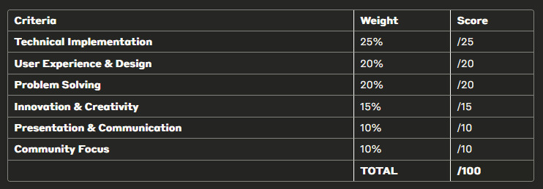
Rubric
An additional 10 Bonus points will be given to teams that are able to fully deploy a functioning front and backend application.

Slide 3
Presentation Title + team name + team members

Slide 4
Agenda
Introductions
Project Summary
Technical Value
Business/Community Value
Demonstration
Q&A

Slide 5
Project Summary
Outline
Overview
Things to consider writing/answering:
What problem are you trying to solve?
What project category does it fall under
How will this impact the community, mosque or everyday life of people you are creating this solution for
Is this a hackDI problem statement or other and why did you choose this?

Slide 6
Solution
Technical
How does the system outperform pre-existing systems (if others exist)?
Does this solve additional problems outside the current defined project summary?
Benefits of the design
How does the structure/functions benefit the overall experience

Slide 7











Sample Workflow slide
3
1
2
11
CLAIMS
SMART TUTOR
BACK-END API
AZURE OPENAI
TRAINED DATA STORED IN CONTAINER
10
4
Automated the steps from 6 to 11
GPT PREPARES TRAINING DATA
9
5
6
7
8
AGENT GIVING NEGATIVE FEEDBACK
FORM TO COLLECT USER EXPERIENCE
POWER AUTOMATE FLOW
GPT ASSESSING SENTIMENT AND RE-PHRASING
FEEDBACK APPROVAL OF TECH TEAM

Slide 8
Solution
Business
What impact on overall customer group could this solution have?
Monetary, efficiency, ease of use
How does this solution elevate what is being done compared to its competitors?

Slide 9
Demo/Prototype
Sub-headline

Slide 10
THANK YOU

Slide 11


Questions?

